Slide 1
UT Runtime/Systems PANDO Update

Slide 2
Outline
Background on Galois and Gluon
Update on runtime progress with Log-structured CSR
Compiler toolchain background and vision
Abelian
IrGL

Slide 3
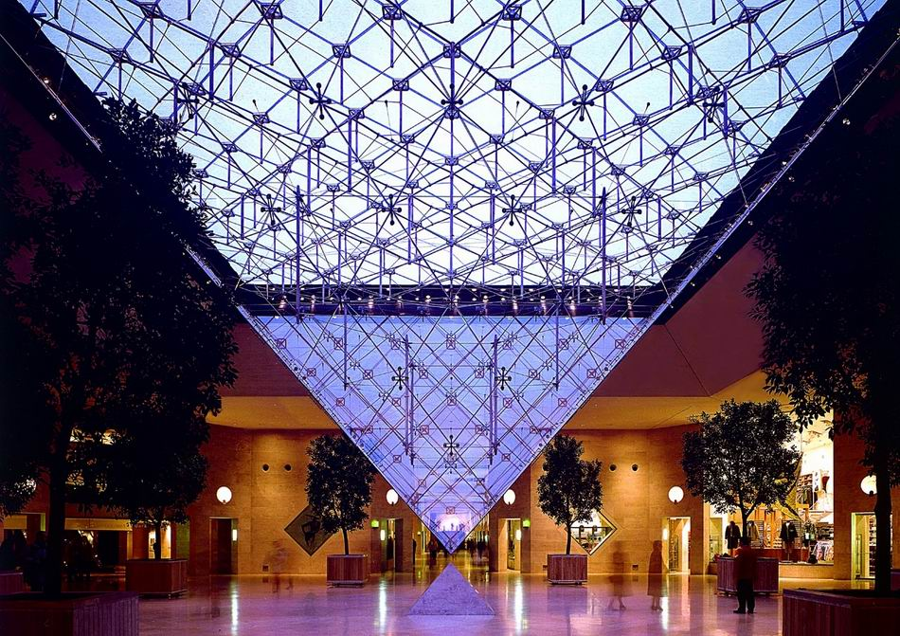
Galois system
Parallel program = Operator + Schedule + Parallel data structures
Ubiquitous parallelism:
small number of expert programmers must support large number of application programmers
cf. SQL
Galois system:
expert: library of concurrent data structures and runtime system
app: application code in sequential C++
Galois set iterator for highlighting opportunities for exploiting ADP
app: Operator + Schedule
expert: Parallel data structures
and runtime system

Slide 4
Hello graph Galois Program
#include “Galois/Galois.h”
#include “Galois/Graphs/LCGraph.h”
struct Data { int value; float f; };
typedef Galois::Graph::LC_CSR_Graph<Data,void> Graph;
typedef Galois::Graph::GraphNode Node;
Graph graph;
struct P {
void operator()(Node n, Galois::UserContext<Node>& ctx) {
graph.getData(n).value += 1;
}
};
int main(int argc, char** argv) {
graph.structureFromGraph(argv[1]);
Galois::for_each(graph.begin(), graph.end(), P());
return 0;
}
Data structure
Declarations
Operator
Galois Iterator

Slide 5
Parallel execution of Galois programs
Application program
Sequential C++
Galois set iterator: for each
New elements can be added to set during iteration
Optional scheduling specification (cf. OpenMP)
Highlights opportunities in program for exploiting amorphous data-parallelism
Runtime system
Ensures serializability of iterations
Execution strategies
Speculation
Interference graphs
Multicore CPU or GPU
Application Program
Master thread
main()
….
for each …..{
…….
…….
}
.....
i₁
i₃
i₂
i₄
Workset
of active nodes
i₅
Graph
Concurrent
data structures
Notes:
Consistency vs isolation

Slide 6
Distributed Galois using Gluon
Programmers:
Write Galois/IrGL applications
Interface with Gluon using API
Gluon transparently handles:
Graph partitioning
Communication and synchronization
GPU
IrGL
Gluon Plugin
CPU
Gluon Comm. Runtime
Galois
CPU
Gluon Plugin
Gluon Comm. Runtime
Gluon Comm. Runtime
CuSP Partitioner
CuSP Partitioner
Network (LCI/MPI)
Network (LCI/MPI)
Galois [SoSP’13]
IrGL [OOPSLA’16]
LCI [IPDPS’18]
CuSP [IPDPS’19]
Notes:
Host-to-device and inter-host communication
API and plugin

Slide 7
Partitioning
Host h1
Host h2
B
C
A
D
F
G
E
H
I
J
Original graph
Partitions of the graph

Slide 8
Partitioning
Host h1
Host h2
Each edge is assigned to a unique host
B
C
A
D
F
G
E
H
I
J
Original graph
Partitions of the graph

Slide 9
Partitioning
Host h1
Host h2
Each edge is assigned to a unique host
All edges connect proxy nodes on the same host
B
C
B
C
B
C
D
A
D
A
F
G
F
G
F
G
E
H
E
H
I
J
I
J
J
Original graph
Partitions of the graph

Slide 10
Partitioning
Host h1
Host h2
Each edge is assigned to a unique host
All edges connect proxy nodes on the same host
A node can have multiple proxies: one is master proxy; rest are mirror proxies
B
C
B
C
B
C
D
A
D
A
F
G
F
G
F
G
E
H
E
H
I
J
I
J
J
: Master proxy
: Mirror proxy
Original graph
Partitions of the graph

Slide 11
How does Gluon synchronize the proxies?
Exploit domain knowledge
Cached copies can be stale as long as they are eventually synchronized
Host h1
Host h2
1
8
B
C
B
C
0
A
8
D
F
G
F
G
1
8
E
8
H
I
J
J
: Master proxy
: Mirror proxy
: distance (label) from source A

Slide 12
How does Gluon synchronize the proxies?
Exploit domain knowledge
Cached copies can be stale as long as they are eventually synchronized
Use all-reduce:
Reduce: mirror proxies to master proxy
Broadcast: master to mirror proxies
Host h1
Host h2
1
B
C
B
C
0
8
A
1
D
F
G
F
G
1
1
E
8
H
I
J
J
: Master proxy
: Mirror proxy
: distance (label) from source A

Slide 13
Gluon Distributed Execution Model
Host h1
Host h2
Gluon partitioner
Gluon partitioner
Galois/CPU IrGL/CUDA on GPU
Galois/CPU
IrGL/CUDA on GPU
Gluon comm. runtime
MPI/LCI
MPI/LCI
Gluon comm. runtime
Galois [SoSP’13]
Ligra [PPoPP’13]
IrGL [OOPSLA’16]
LCI [IPDPS’18]

Slide 14
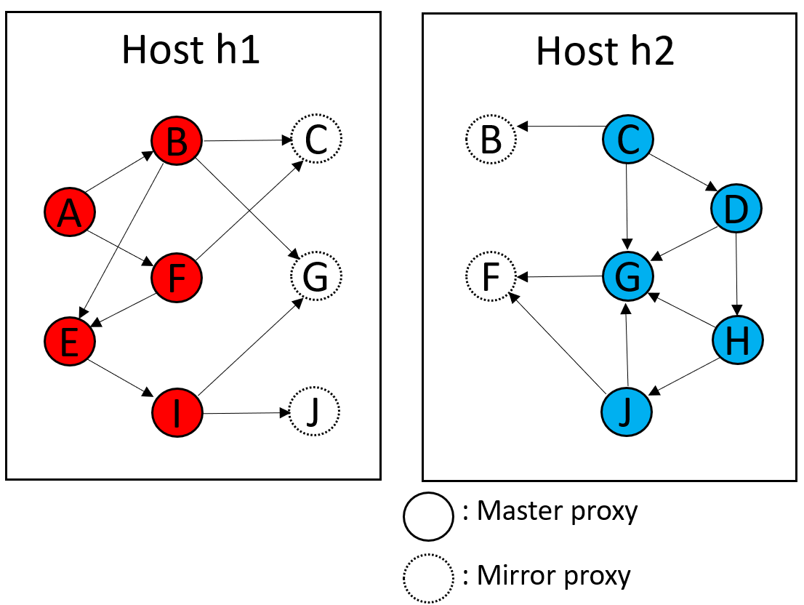
Key Research Question
Do we need overlapping partitions for PANDO?
PGAS address space
Hide latency with Massive MT
Proxies will still have benefit:
Locality → lower latency
Batched communication
Are the benefits worth it?
Performance modeling to the rescue?

Slide 15
Log Structured CSR
Key ideas
CSR: great read performance, poor write performance
Log-structure →
preserves read locality for evolving CSR
Append-only writes → better write performance
Key questions
Representation for topology
Representation for properties
Synchronization design

Slide 16
Background: LPGs
Labeled property graphs
TBD
Notes:
Add text for what is what; add animations if time

Slide 17
Background: CSR
CSR is an efficient way to represent sparse graphs
But not efficiently updateable
Represents topology only
Compressed Sparse Row
Vertex Array
Edge Array
Goals:
Increase cache-ability of graph
Represent sparse data efficiently
We need to cover adding properties
0
CSR
0
1
2
3
09-15;
2,000,000
2
1
1
2
3
Notes:
Add text for what is what; add animations if time

Slide 18
Background: EL
Edgelist
Efficiently updatable
Poor locality for read-dominated workloads
Morph Graph: a fast EL variant
Exponential growth of edge list arrays instead of linked lists
Trade memory for locality, amortize allocation overheads

Slide 19
Ingesting Updates
Evolving graphs evolve
So our structure needs to accommodate these changes
Changes to Understand:
Adding a Node
Adding an Edge
Batch additions
Topology updates: additions only
Deletions are trivial to support but not needed
Updates: delete → add, but also not needed

Slide 20
Adding a Node
Vertex Addition is fast:
append to the Vertex Array
(vertex ids implicit)
(already fast with CSR)
Global ID | Local ID
805674 | 0
8596874 | 1
789565 | 2
56444564 | 3
0
1
2
4
6
0
3
0
0
1
0
2
2
1
3
Global ID | Local ID
805674 | 0
8596874 | 1
789565 | 2
56444564 | 3
56465 | 4
0
1
2
4
6
7
4
3
0
0
1
0
2
3
Notes:
Change all blue things to grey (you think it is green)

Slide 21
Adding an Edge
0
1
2
4
6
Adding to the edge array usually requires shifting
Worst case copies the entire edge array
0
3
0
0
1
0
2
Requires Recreating the CSR
2
1
3
0
1
3
5
7
3
0
2
0
1
0
2

Slide 22
Log Structured CSR
Edge Addition is easier with an explicit edge list
Idea: turn all updates into appends
Implementation:
Add edge → copy updated edge list to end of edge array
Previous Edges are tomb-stoned
Problem: edge lists / neighbor vertices no longer contiguous
Solution: Store edge start/end in a vertex entry
0
0,1
1,2
2,4
4,6
2
1
3
0
0
1
0
2
3
Notes:
Re-label the edges to make this hard

Slide 23
Log Structured CSR
Edge Addition is easier with an explicit edge list
Idea: turn all updates into appends
Implementation:
Add edge → copy updated edge list to end of edge array
Previous Edges are tomb-stoned
Problem: edge lists / neighbor vertices no longer contiguous
Solution: Store edge start/end in a vertex entry
0,1
1,2
2,4
4,6
0
3
0
0
1
0
2
2
1
3
0,1
6,8
2,4
4,6
3
0
0
1
0
2
0
3
Notes:
Re-label the edges to make this hard

Slide 24
Deleting an Edge
Idea: Steal a bit to Tombstone in the Edge (Shown by black interior)
0,1
1,2
2,4
4,6
0
3
0
0
1
0
2
2
1
3
0,1
1,2
2,4
4,6
The edge will still be traversed, just ignored
3
0
0
1
0
2

Slide 25
Deleting a Node
Idea: Steal a bit to Tombstone in the Node (Shown by black interior)
0,1
1,2
2,4
4,6
0
3
0
0
1
0
2
2
1
3
0,1
1,2
2,4
4,6
Edges sourced at 2 are now unreachable
Edges traversals with a destination of 2 must check
3
0
0
1
0
2
Notes:
Actually put a tombstone

Slide 26
Labels/Properties
CSR can easily query a labeled property Key-Value Store
Properties for nodes are keyed using their index in the Vertex array Properties for edges are keyed by using both the source index and destination index.
This is preserved in our semantics assuming no duplicate edges.

Slide 27
Design Alternatives: Log Structured CSR Variants
Benchmarking Variants shows how Packing Data within the CSR representation performs.
Vertex and Edge Handle Alternatives
LS_CSR with Out of Line Locking (separate lock array)
LS_CSR with Packed Values for Locking (locks steal bits from IDs)
Representing Properties
LS_CSR with Out of Line Properties (properties in separate arrays)
LS_CSR with Packed Edge Properties
LS_CSR with Packed Node Properties
LS_CSR with both Packed Properties
PANDO: properties in DKV store (e.g. Memcached)
Hypothesis: best representation depends on level of heterogeneity

Slide 28
Methodology
Workloads:
Single-Source Shortest Path (BFS)
Jaccard Similarity
Underlying Structure:
Morph Graph (Galois’ Resident EdgeList)
Regular CSR -> recomputed on each edit
Log Structured CSR variants
Update intensity:
No Edits
n/8 of the Graph ingested
Metrics of Interest:
Total Cycles
Cycles spent Editing
Cycles spent on Workload
Micro-arch counters collected will be on auxiliary slides
Sequential only
Hardware
14 Core 2.90 GHz Intel(R) Xeon(R) CPU E5-2680 v4
Frequency scaling disabled
SMT disabled
L1d 32KiB per core
L1i 32KiB per core
L2 250KiB per core
L3 35 MiB Unified
1 NUMA Node
GCC (G++) 9.4.0
O3
Inputs
Yelp: 13954819 edges, 716847 nodes
Citeseer: 4676 edges, 3326 nodes
Cora: 5278 edges, 2708 nodes

Slide 29
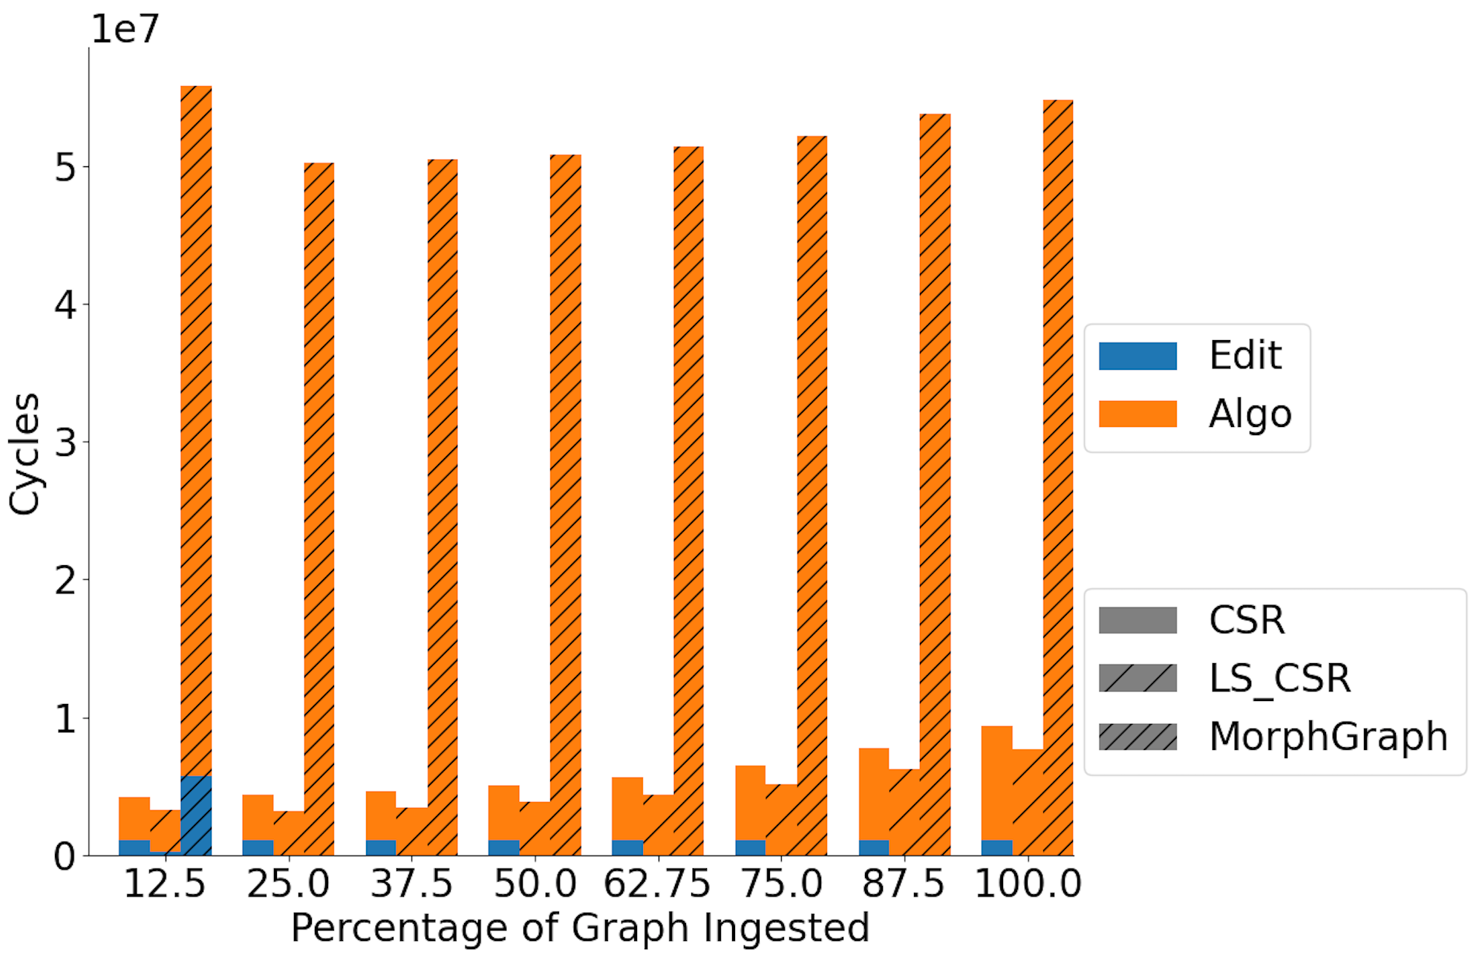
Preliminary Data BFS on Citeseer

Slide 30
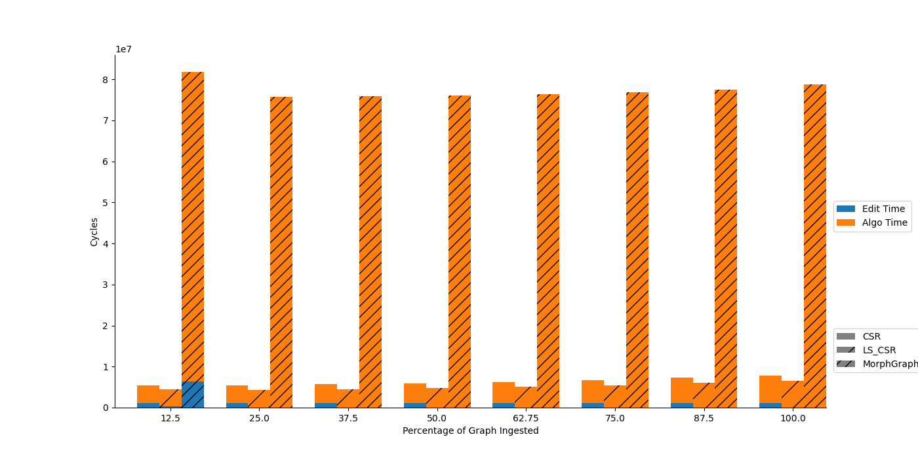
Preliminary Data Jaccard on Citeseer

Slide 31
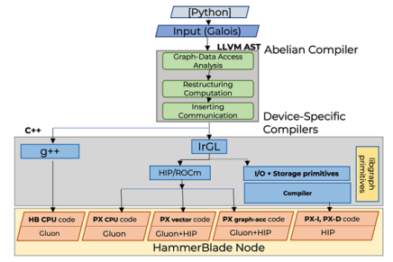
PANDO Compiler Toolchain
Galois programming model
Parallel patterns
Concurrent data structures
LLVM-based backend
CPU binaries
S2S → CUDA, ROCm, OpenCL
BSP+MPI execution model
Multiple Layers of Compilers
Abelian: Galois->BSP+CUSP
IrGL: Galois->Accelerators

Slide 32
PANDO Compilation Flow Key Ideas
Accept High-level Specification
Abelian Compiler
Transforms shared memory graph algorithms → distributed
Inserts communication primitives (Gluon/MPI)
RQ1: Role of vertex programs, overlapping partitions
RQ2: Adapting comm. model + Abelian to PANDO HW and lower-layer RTs
IrGL Compiler
Compiler for *kernels*
HLL spec → Accelerator spec (e.g. CUDA/OpenCL)
RQ3: Defining primitives/interfaces for PX-* accelerators
RQ4: How to retarget IrGL to PANDO accelerators

Slide 33
IrGL Compiler Key Ideas
Start from a high-level description of algorithm
Use optimizing compiler to generate accelerator code
IrGL targeted bottlenecks for irregular parallelism on GPUs
Atomics
Inner-loop serialization and load balance
Kernel launch overhead
Observations
All likely relevant on PX-vector processors
Will help with SIMD/SIMT parallelism on other PX-*,
But not necessarily with graph primitives like Set operations, layout transformations, etc.

Slide 34
IrGL on a slide Representation for irregular data-parallel algorithms
not worklist.empty()
refine_mesh
chk_bad_tri
Parallelism/Control | Synchronization | Worklist Management
Kernel launch
Kernel/Invoke ident(…)
Parallel forall
ForAll(… in Worklist)
Parallel iteration
Iterate ident(…) […] { LEVEL++ }
Atomic: blocking Atomic (lock) { critical section }
Exclusive: non-blocking, obtains multiple locks with priority Exclusive (locks) { critical section }
Pipe: kernels share worklist
Pushed items forwarded to the next (dynamic) kernel
Pipe: a general form of Iterate on worklists
Pipe { // input: bad triangles // output: new triangles Invoke refine_mesh(...)
// check new bad tri.
Invoke chk_bad_tri(...) }

Slide 35
Example: Level-by-Level BFS
0
1
1
1
2
2
2
2
2
2
Kernel bfs(graph, LEVEL)
ForAll(node in Worklist)
ForAll(edge in graph.edges(node))
if(edge.dst.level == INF)
edge.dst.level = LEVEL
Worklist.push(edge.dst)
src.level = 0
Iterate bfs(graph, LEVEL) [src] { LEVEL++ }

Slide 36
Bottleneck #1: Atomics
Kernel bfs(graph, LEVEL)
ForAll(node in Worklist)
ForAll(edge in graph.edges(node))
if(edge.dst.level == INF)
edge.dst.level = LEVEL
Worklist.push(edge.dst)
src.level = 0
Iterate bfs(graph, LEVEL) [src] { LEVEL++ }
Solution: support aggregation at warp/thread-block level:
Kernel bfs_kernel(graph, ...)
ForAll(node in Worklist)
ForAll(edge in graph.edges(node))
if(edge.dst.level == INF)
...
start = Worklist.reserve_*(X)
Worklist.write(start, edge.dst)
pos = atomicAdd(Worklist.length, 1)
Worklist.items[pos] = edge.dst

Slide 37
Bottleneck #2: Launching Short Kernels
Solution: Iteration Outlining
“Outline” Iterate to GPU
single control kernel
launch → function calls
Iterate → function calls
CPU
GPU
CPU
GPU
launch
launch
Kernel bfs(graph, LEVEL)
ForAll(node in Worklist)
ForAll(edge in graph.edges(node))
if(edge.dst.level == INF)
edge.dst.level = LEVEL
Worklist.push(edge.dst)
src.level = 0
Iterate bfs(graph, LEVEL) [src] { LEVEL++ }
bfs
bfs
Idling
bfs
bfs
bfs
Idling
bfs
bfs
Control Kernel
Idling
bfs
Time
Time

Slide 38
Bottleneck #3: Inner-loop serialization
Solution: General Scheme for Nested Parallelism
Use Inspector/Executor Approach
Compiler generates schedulers
High-degree → TB scheduling
Low-degree → FG scheduling
Use auto-tuning to select
Kernel bfs(graph, LEVEL)
ForAll(node in Worklist)
ForAll(edge in graph.edges(node))
if(edge.dst.level == INF)
edge.dst.level = LEVEL
Worklist.push(edge.dst)
src.level = 0
Iterate bfs(graph, LEVEL) [src] { LEVEL++ }
a
b
c
d
e
f
Power-law graphs can have millions of edges per node
Thread-block Scheduling
One node per thread
(Inner loop serialized)
a
b
c
d
e
f
Fine-grained Scheduling

Slide 39
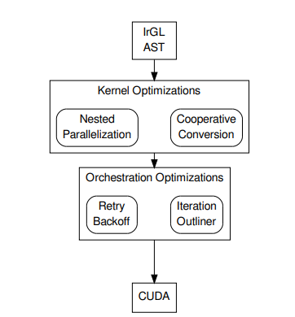
IrGL Compiler Mechanics
Converts IrGL abstract syntax trees to CUDA
Generated CUDA code embedded into programs
IrGL intended for writing kernels, not full programs
Implemented as a library
Python-callable
IrGL ASTs are valid Python programs
RQ3: Defining primitives/interfaces for PX-* accelerators
RQ4: How to retarget IrGL to PANDO accelerators

Slide 40
Abelian
Gluon[PLDI’18] provides efficient high level bulk synchronous API for synchronization:
A communication substrate to build distributed and heterogeneous graph analytics systems
Provides:
Graph partitioner (Edge-cuts and Vertex-cuts)
Communication-optimized runtime:
Exploits partitioning structural invariants
Avoids sending unnecessary meta-data
Abelian required:
To insert Gluon API calls for distributed execution
Provide information to exploit Gluon optimization
GPU
IrGL/CUDA/...
Gluon Plugin
CPU
Gluon Comm. Runtime
Galois/Ligra/...
CPU
Gluon Plugin
Gluon Comm. Runtime
Gluon Comm. Runtime
Partitioner
Partitioner
Network (LCI/MPI)
Network (LCI/MPI)
Galois [SoSP’13]
Ligra [PPoPP’13]
IrGL [OOPSLA’16]
LCI [IPDPS’18]

Slide 41
Shared Memory Galois PageRank (Input)
struct pageRank() {
Graph* g
pageRank(Graph* g) : g(g) {}
void operator()(GNode src, Worklist& wl) {
auto& srcData = g->getData(src);
auto residual_old = srcData.residual.exchange(0);
srcData.rank += residual_old;
auto delta = residual_old*alpha/srcData.nout;
for(auto e : g->getEdges(src)) {
GNode dst = g->getEdgeDst(e);
auto& dstData = g->getData(dst);
dstData.residual += delta;
if(dstData.residual > tolerance) {
wl.push(dst);
}
}
}
}
while (!wl.empty()) { Galois::do_all(wl, pageRank{&g}; }
Graph node labels:
rank, residual, nout
Asynchronous execution
Push-style operator
Update residual on immediate neighbors
Work-list based
Apply operator to items in work-list
Push new active nodes to work-list
Notes:
Animation in the code.
Include do_all
And node attributes
Just this much code….. Simple code + compiler will handle everything
nothing distributed , nothing device specific;… don’t read the code + this is all the code

Slide 42
Distributed Heterogeneous PageRank (Output)
do{
Galois:do_all (graph.getSources(), pageRank{&graph, alpha, tolerance});
Flag_rank.set_writeSrc();
Flag_contrib.set_reduceDst();
If(Flag_contrib.is_reduceDst()) {
graph.sync<reduceDst, readSrc, Add_contrib, Bcast_contrib>(Bitvec_contrib);
Flag_contrib.reset_reduceDst();
} else if (Flag_contrib.is_reduceDst()) {
…
} else { … }
Galois:do_all (graph.getSources(), pageRank_split{&graph});
Flag_residual.set_writeSrc();
}while(work_done.reduce());
struct pageRank() {
Graph* g
pageRank(Graph* g) : g(g) {}
DistributedAcc work_done;
void operator()(GNode src,
Worklist& wl) {
if(srcData.residual > tolerance) {
…
for(auto e : g->getEdges(src)) {
…
dstData.contrib += delta;
}
}}
struct pageRank_split() {
Graph* g;
void operator()(GNode src) {
auto& srcData = g->getData(src);
srcData.residual += srcData.contrib;
srcData.contrib = 0;
}
Graph node labels:
rank, residual, nout, contrib
BSP style execution
Operators:
pageRank and pageRank_split
Filter-based data-driven
On-demand communication
Gluon sync calls

Slide 43
Input to output
Code Transformations:
Required transformation
Asynchronous to BSP style of execution
Closure conversion for heterogeneous execution
Optimization transformation
Work-list elimination
Communication optimizations:
On-demand communication
Fine-grain synchronizations

Slide 44
Code Transformations

Slide 45
Asynchronous to BSP Execution
Fine-grain synchronization needed
Reading and writing residual at source
Updating residual at destination on immediate neighbors
BSP execution does not permit fine grain synchronization
Hosts see different values during computation phase due to disjoint address space
Requires synchronization
struct pageRank() {
Graph* g
pageRank(Graph* g) : g(g) {}
void operator()(GNode src, Worklist& wl) {
auto& srcData = g->getData(src);
auto residual_old = srcData.residual.exchange(0);
srcData.rank += residual_old;
auto delta = residual_old*alpha/srcData.nout;
for(auto e : g->getEdges(src)) {
GNode dst = g->getEdgeDst(e);
auto& dstData = g->getData(dst);
dstData.residual += delta;
if(dstData.residual > tolerance) {
wl.push(dst);
}
}
}

Slide 46
Restructuring Computation: Required Transformation 1
Fine-Grain iteration-level to round based BSP
Splitting operator:
PageRank: read and write access
PageRank_split: reduction
Introduce new variables (contrib)
struct pageRank() {
Graph* g;
float &local_alpha, &local_tolerance
pageRank(Graph* g) : g(g) {}
void operator()(GNode src, Worklist& wl) {
auto& srcData = g->getData(src);
auto residual_old = srcData.residual.exchange(0);
srcData.rank += residual_old;
auto delta = residual_old*local_alpha/srcData.nout;
for(auto e : g->getEdges(src)) {
GNode dst = g->getEdgeDst(e);
auto& dstData = g->getData(dst);
dstData.contrib += delta;
if(dstData.contrib > local_tolerance) {
wl.push(dst);
}
} }
struct pageRank_split() {
Graph* g;
pageRank_split(Graph* g) : g(g) {}
void operator()(GNode src) {
auto& srcData = g->getData(src);
srcData.residual += srcData.contrib;
srcData.contrib = 0;
}

Slide 47
Transformations for Heterogeneous Execution
Global variables present
tolerance and alpha
Heterogenous hosts may not share common visible memory space
struct pageRank() {
Graph* g
pageRank(Graph* g) : g(g) {}
void operator()(GNode src, Worklist& wl) {
auto& srcData = g->getData(src);
auto residual_old = srcData.residual.exchange(0);
srcData.rank += residual_old;
auto delta = residual_old*alpha/srcData.nout;
for(auto e : g->getEdges(src)) {
GNode dst = g->getEdgeDst(e);
auto& dstData = g->getData(dst);
dstData.contrib += delta;
if(dstData.contrib > tolerance) {
wl.push(dst);
}
}
}

Slide 48
Restructuring Computation: Required Transformation 2
Eliminating global variables:
Make operators self contained (closure conversion)
Introduce corresponding local variables
struct pageRank() {
Graph* g;
float &local_alpha, &local_tolerance
pageRank(Graph* g) : g(g) {}
void operator()(GNode src, Worklist& wl) {
auto& srcData = g->getData(src);
auto residual_old = srcData.residual.exchange(0);
srcData.rank += residual_old;
auto delta = residual_old*local_alpha/srcData.nout;
for(auto e : g->getEdges(src)) {
GNode dst = g->getEdgeDst(e);
auto& dstData = g->getData(dst);
dstData.contrib += delta;
if(dstData.contrib > local_tolerance) {
wl.push(dst);
}
} }
Local Variables

Slide 49
Optional Optimization Transformation
Work-list elimination Optimization
Distributed work-list required
Needs synchronization
struct pageRank() {
Graph* g;
float &local_alpha, &local_tolerance
pageRank(Graph* g) : g(g) {}
void operator()(GNode src, Worklist& wl) {
auto& srcData = g->getData(src);
auto residual_old = srcData.residual.exchange(0);
srcData.rank += residual_old;
auto delta = residual_old*local_alpha/srcData.nout;
for(auto e : g->getEdges(src)) {
GNode dst = g->getEdgeDst(e);
auto& dstData = g->getData(dst);
dstData.contrib += delta;
if(dstData.residual > local_tolerance) {
wl.push(dst);
}
} }

Slide 50
Restructuring Computation: Optimization Transformation
Conversion to filter based data-driven algorithm:
Avoid distributed work-list synchronization overhead
Conditional used to push work is used to filter
struct pageRank() {
Graph* g;
float &local_alpha, &local_tolerance
pageRank(Graph* g) : g(g) {}
void operator()(GNode src, Worklist& wl) {
auto& srcData = g->getData(src);
if(srcData.residual > local_tolerance) {
auto residual_old = srcData.residual.exchange(0);
srcData.rank += residual_old;
auto delta = residual_old*local_alpha/srcData.nout;
for(auto e : g->getEdges(src)) {
GNode dst = g->getEdgeDst(e);
auto& dstData = g->getData(dst);
dstData.contrib += delta;
}
}

Slide 51
Analysis and Inserting communication
Notes:
1. After doing the required transformations, we will now look at how compiler analyses the code and inserts the communication for distributed execution

Slide 52
Information Required by Gluon Synchronization API
Application-specific:
What: Field to synchronize
When: Point of synchronization
How: Reduction operator to use
Optional information for optimization:
Field specific bit-set to track updated fields
Precise read and write locations for exploiting structural invariant optimization

Slide 53

Graph-Data Access Analysis
Input
Galois
Fields accessed on graph Nodes (What)
Operator field access types (How) :
Reduction: Field is read and updated using reduction operation (inside edge iterator)
Read: Field is only read
Write: Field is written (not part of a reduction)
Operator field access location:
At source: At the source of an edge
At destination: At the destination of an edge
At any: At the node or both end points of edge
LLVM AST
Abelian
Compiler
Graph-Data Access Analysis
Restructuring Computation
Inserting Communication
Device Specific
Compilers
C++
g++
IrGL
CUDA
OpenCL
CPU code
GPU code
Gluon Runtime
Gluon Runtime

Slide 54
PageRank Example
Field accessed: contrib, residual, rank
Reduction operation (contrib): +=
Field accessed location:
residual and rank
Read at source
contrib
Updated at destination
struct pageRank() {
Graph* g;
float &local_alpha, &local_tolerance
pageRank(Graph* g) : g(g) {}
void operator()(GNode src, Worklist& wl) {
auto& srcData = g->getData(src);
if(srcData.residual > local_tolerance) {
auto residual_old = srcData.residual.exchange(0);
srcData.rank += residual_old;
auto delta = residual_old*local_alpha/srcData.nout;
for(auto e : g->getEdges(src)) {
GNode dst = g->getEdgeDst(e);
auto& dstData = g->getData(dst);
dstData.contrib += delta;
}
}

Slide 55
Inserting Communication
Input
Galois
LLVM AST
Abelian
Compiler
Graph-Data Access Analysis
Restructuring Computation
Inserting Communication
Device Specific
Compilers
C++
g++
IrGL
CUDA
OpenCL
CPU code
GPU code
Gluon Runtime
Gluon Runtime
Notes:
Now let’s look at how Abelian inserts communication

Slide 56
Inserting Naïve Communication: UnOptimized PageRank
Inserting Gluon sync API calls
struct pageRank() {
Graph* g;
float &local_alpha, &local_tolerance
pageRank(Graph* g) : g(g) {}
void operator()(GNode src, Worklist& wl) {
…
}
}
while(!workDone){
Galois:do_all (graph.getSources(), pageRank{&graph, alpha, tol});
graph.sync<reduceAny, readAny, Add_contrib, Bcast_contrib>();
Galois:do_all (graph.getSources(), pageRank_split{&graph});
graph.sync<reduceAny, readAny, Add_residual, Bcast_residual>();
}
struct pageRank_split() {
Graph* g;
pageRank_split(Graph* g) : g(g) {}
void operator()(GNode src) {
…
}
}

Slide 57
Communication optimizations Optimization 1:
PageRank Operator
Contrib updated
Naïve synchronization:
Conservative approach
contrib updated in pageRank operator
PageRank_split Operator
Contrib read
Data flow diagram
Contrib variable

Slide 58
Communication optimizations Optimization 1:
PageRank Operator
Contrib updated
Sync contrib
Naïve synchronization:
Conservative approach
contrib updated in pageRank operator
Sync contrib after pageRank operator
PageRank_split Operator
Contrib read
Data flow diagram
Contrib variable

Slide 59
Communication optimizations Optimization 1:
PageRank Operator
Contrib updated
On-demand synchronization:
Only sync before operator if required
Sync before using contrib on-demand in pageRank_split before reading
PageRank_split Operator
Contrib read
Sync contrib
Data flow diagram
Contrib variable

Slide 60
Communication optimizations Optimization 1:
Inserting on-demand communication:
Field specific sync-state flags
Before operator:
Checks sync-state flags with precise read/write location provided by Abelian
Calls Gluon sync if required.
After operator:
Inserts code to set or invalidate field-specific sync-state flags (uses write location)
Notes:
Additional information from Abelian:
Abelian precisely identifies abstract read and write location
Exploits Gluon’s structural invariant optimization

Slide 61
Inserting On-demand Communication: PageRank example
Inserting on-demand communication
Insert and Set sync flags
Check sync flags and insert Gluon sync calls
Galois:do_all (graph.getSources(), pageRank{&graph,
alpha, tolerance});
Flag_rank.set_writeSrc();
Flag_contrib.set_reduceDst();
If(Flag_contrib.is_reduceDst()) {
graph.sync<reduceDst, readSrc, Add_contrib,
Bcast_contrib>(Bitvec_contrib);
Flag_contrib.reset_reduceDst();
} else if (Flag_contrib.is_reduceDst()) {
…
} else { … }
Galois:do_all (graph.getSources(), pageRank_split{&graph});
Flag_residual.set_writeSrc();
Notes:
1. It adds extra logic to check and set/invalidate sync flags

Slide 62
A Compiler for Throughput Optimization of Graph Algorithms on GPUs
Sreepathi Pai Keshav Pingali
The University of Texas at Austin
November 16, 2016

Slide 63
Outline
Approaches to Graph Algorithms on GPUs
IrGL Compiler and Optimizations
Bottleneck #1: Atomics
Bottleneck #2: Inner-loop Serialization
Bottleneck #3: Short Kernel Launches
Results
Performance Models for Graph Algorithms on GPUs

Slide 64
Approaches to Graph Algorithms on GPUs

Slide 65
Graph Algorithms on GPUs
GPUs excel on regular data-parallel code
e.g. Matrix Multiply
Graph algorithms on GPUs?
Good: Require lots of bandwidth
GPU memory bandwidth is 288GB/s
CPU memory bandwidth is 25GB/s
Bad: Data-parallel, but not regular

Slide 66
Approach #1: CUDA/OpenCL Implementations
Breadth-First Search (BFS) [Merrill et al., 2012]
Connected Components (CC) [Soman et al., 2010]
Delaunay Mesh Refinement (DMR) [Nasre et al., 2013]
Maximal Independent Set (MIS) [Che et al., 2013]
Minimum Spanning Tree (MST) [da Silva Sousa et al. 2015]
PageRank (PR) [Elsen and Vaidyanathan, 2014]
Single-Source Shortest Path (SSSP) [Davidson et al. 2014]
Triangle Counting (TRI) [Polak et al. 2015]

Slide 67
Approach #2: Graph Analytics Frameworks
C++ Template-based Frameworks
VertexAPI2 [Elsen and Vaidyanathan, 2014]
MapGraph [Fu et al, GRADES 2014]
Gunrock [Wang et al., PPoPP 2016]
Targeted towards graph analysts
Restricted to limited set of algorithms
Vertex programs
Immutable graphs

Slide 68
Our Approach: IrGL Compiler
Start from a high-level description of algorithm
Use optimizing compiler to generate CUDA
Advantages
Raises abstraction level for programmers
Does not sacrifice performance
Allows automatic exploration of optimizations
Road networks often require different optimizations compared to social networks

Slide 69
Haven't we seen these before?
Construct | OpenACC | PPCG | OpenMP 4.0 | FALCON | IrGL
ForAll | Y | Y | Y | Y | Y
Atomic | Y | N | Y | Y | Y
Exclusive | N | N | Y | Y | Y
Graph Traversal Microbenchmark | 13ms | 13ms | 63ms | - | 2ms
6.5x faster

Slide 70
A Compiler for Throughput Optimization of Graph Programs*
* To appear in OOPSLA 2016
We wrote an optimizing compiler for IrGL
Three core optimizations:
Cooperative Conversion
Nested Parallelism
Iteration Outlining
Claim: Impossible to write a high-performance GPU graph program without these optimizations (if applicable)

Slide 71
Thread-Level Aggregation
Kernel example(graph, LEVEL)
ForAll(node in Worklist)
size = len(graph.edges(node))
start = Worklist.reserve(size)
ForAll(edge in graph.edges(node))
Worklist.write(start, edge) start++
Change atomicAdd(1) to atomicAdd(size)
Ordinary write
Going from 1 atomic/push to 1 atomic/thread:

Slide 72
Distributed Graph Analytics
Applications:
Datasets: unstructured graphs
Pathfinding
Recommendations
Searching
Centrality / Importance
Need TBs of memory
Credits: yola,edutopiaglobal.com slideshare, amazon.com
Credits: Sentinel Visualizer
Notes:
Graph analytics:
1. random memory access
2. unpredictable control flow

Slide 73
Vertex Programming Model
Every node has a label
e.g., distance in single source shortest path (SSSP)
Apply an operator on an active node in the graph
e.g., relaxation operator in SSSP
Push-style: reads its label and writes to neighbors’ labels
Pull-style: reads neighbors’ labels and writes to its label
Termination: no more active nodes (or work)
Applications: breadth first search, connected component, k-core, pagerank, single source shortest path, betweenness centrality, etc.
R
W
push-style
R
W
pull-style

